Slide 1
Generalised Verification for Quantified Permissions
Intermediate Presentation of Master Thesis Project
Nadja Müller
Supervisor: Alex Summers

Slide 2

Quantified Permissions
Current Structure:
$$forall x:T ∷c\left(x\right)⇒acc\left(e\left(x\right).f, p\left(x\right)\right)$$
c(x): boolean expression
e(x): injective, reference-typed expression
p(x): permission expression
Example:
$$forall x:Ref ∷x in xs⇒acc\left(x.f, write\right)$$

Slide 3
Core Goals
Design & Implementation (Carbon & Silicon):
combinations of quantified pure and permission-based assertions
predicate support within quantified permissions
Design:
magic wand support within quantified permissions
nested quantified permissions

Slide 4

Quantified Permissions
Overview:
$$forall x:T ∷c\left(x\right)⇒acc\left(e\left(x\right).f, p\left(x\right)\right)$$

Slide 5

Quantified Permissions
Overview:
$$forall x:T ∷c\left(x\right)⇒acc\left(e\left(x\right).f, p\left(x\right)\right)$$
$$forall x:T ∷c\left(x\right)⇒acc\left(pred\left(e_{1}(x),…,e_{n}(x)\right), p\left(x\right)\right)$$

Slide 6

Quantified Permissions
Overview:
$$forall x:T ∷c\left(x\right)⇒acc\left(e\left(x\right).f, p\left(x\right)\right)$$
$$forall x:T ∷c\left(x\right)⇒acc\left(pred\left(e_{1}(x),…,e_{n}(x)\right), p\left(x\right)\right)$$
$$forall x:T ∷c\left(x\right)⇒\left(A −−∗B\right)$$

Slide 7

Quantified Permissions
Overview:
$$forall x:T ∷c\left(x\right)⇒acc\left(e\left(x\right).f, p\left(x\right)\right)$$
$$forall x:T ∷c\left(x\right)⇒acc\left(pred\left(e_{1}(x),…,e_{n}(x)\right), p\left(x\right)\right)$$
$$forall x:T ∷c\left(x\right)⇒\left(A −−∗B\right)$$
$forall x:T ∷c\left(x\right)⇒(b\left(x\right)⇒exp$r)

Slide 8

Quantified Permissions
Overview:
$$forall x:T ∷c\left(x\right)⇒acc\left(e\left(x\right).f, p\left(x\right)\right)$$
$$forall x:T ∷c\left(x\right)⇒acc\left(pred\left(e_{1}(x),…,e_{n}(x)\right), p\left(x\right)\right)$$
$$forall x:T ∷c\left(x\right)⇒\left(A −−∗B\right)$$
$forall x:T ∷c\left(x\right)⇒(b\left(x\right)⇒exp$r)
$$forall x:T ∷c\left(x\right)⇒{expr}_{1} \&\& {expr}_{2}$$

Slide 9

Quantified Permissions
Overview:
$$forall x:T ∷c\left(x\right)⇒acc\left(e\left(x\right).f, p\left(x\right)\right)$$
$$forall x:T ∷c\left(x\right)⇒acc\left(pred\left(e_{1}(x),…,e_{n}(x)\right), p\left(x\right)\right)$$
$$forall x:T ∷c\left(x\right)⇒\left(A −−∗B\right)$$
$forall x:T ∷c\left(x\right)⇒(b\left(x\right)⇒exp$r)
$$forall x:T ∷c\left(x\right)⇒{expr}_{1} \&\& {expr}_{2}$$
$$forall{ x}_{1}:T_{1}∷c\left(x_{1}\right) ⇒(forall{ x}_{2}:T_{2}∷c\left(x_{1}, x_{2}\right)⇒ …)$$

Slide 10

Quantified Permissions
Overview:
$$forall x:T ∷c\left(x\right)⇒acc\left(e\left(x\right).f, p\left(x\right)\right)$$
$$forall x:T ∷c\left(x\right)⇒acc\left(pred\left(e_{1}(x),…,e_{n}(x)\right), p\left(x\right)\right)$$
$$forall x:T ∷c\left(x\right)⇒\left(A −−∗B\right)$$
$forall x:T ∷c\left(x\right)⇒(b\left(x\right)⇒exp$r)
$$forall x:T ∷c\left(x\right)⇒{expr}_{1} \&\& {expr}_{2}$$
$$forall{ x}_{1}:T_{1}∷c\left(x_{1}\right) ⇒(forall{ x}_{2}:T_{2}∷c\left(x_{1}, x_{2}\right)⇒ …)$$
$$forall x_{1}:T_{1},…,x_{n}:T_{n}∷c\left(x_{1}, …,x_{n}\right)⇒acc\left(e\left(x_{1}, …,x_{n}\right).f, p\left(x_{1}, …,x_{n}\right)\right)$$

Slide 11
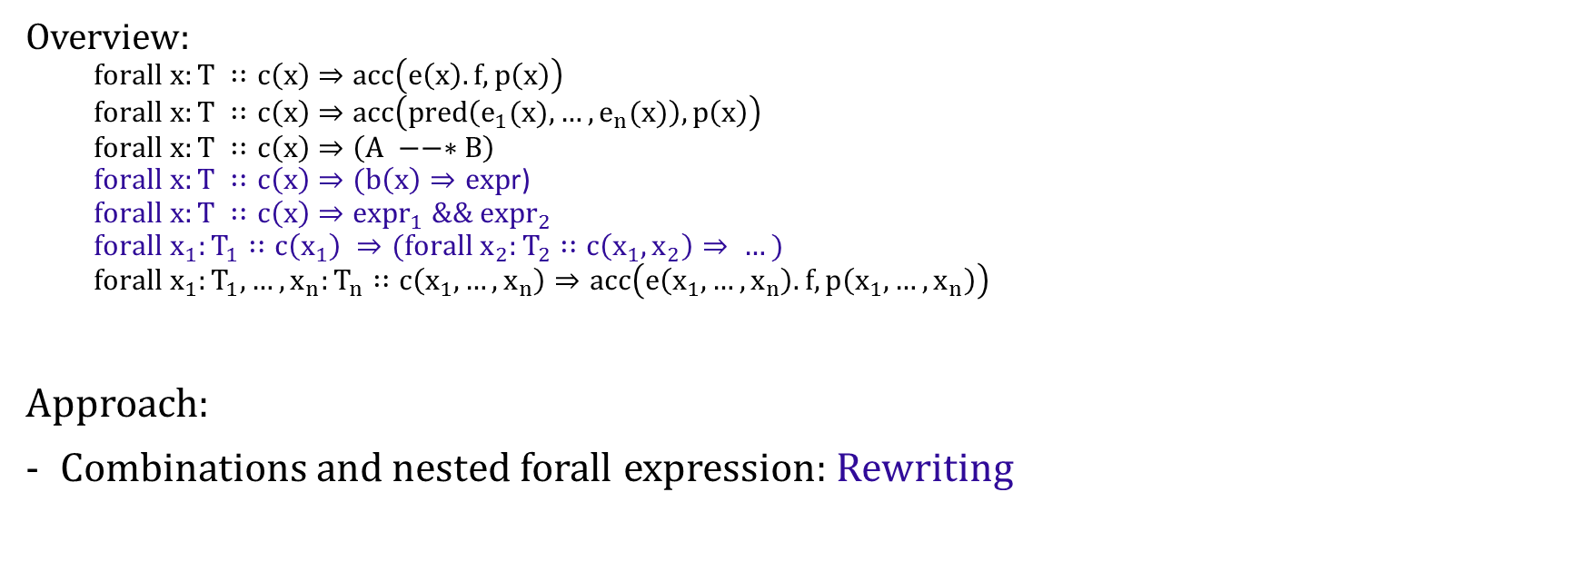
Quantified Permissions
Overview:
$$forall x:T ∷c\left(x\right)⇒acc\left(e\left(x\right).f, p\left(x\right)\right)$$
$$forall x:T ∷c\left(x\right)⇒acc\left(pred\left(e_{1}(x),…,e_{n}(x)\right), p\left(x\right)\right)$$
$$forall x:T ∷c\left(x\right)⇒\left(A −−∗B\right)$$
$forall x:T ∷c\left(x\right)⇒(b\left(x\right)⇒exp$r)
$$forall x:T ∷c\left(x\right)⇒{expr}_{1} \&\& {expr}_{2}$$
$$forall{ x}_{1}:T_{1}∷c\left(x_{1}\right) ⇒(forall{ x}_{2}:T_{2}∷c\left(x_{1}, x_{2}\right)⇒ …)$$
$$forall x_{1}:T_{1},…,x_{n}:T_{n}∷c\left(x_{1}, …,x_{n}\right)⇒acc\left(e\left(x_{1}, …,x_{n}\right).f, p\left(x_{1}, …,x_{n}\right)\right)$$
Approach:
Combinations and nested forall expression: Rewriting

Slide 12
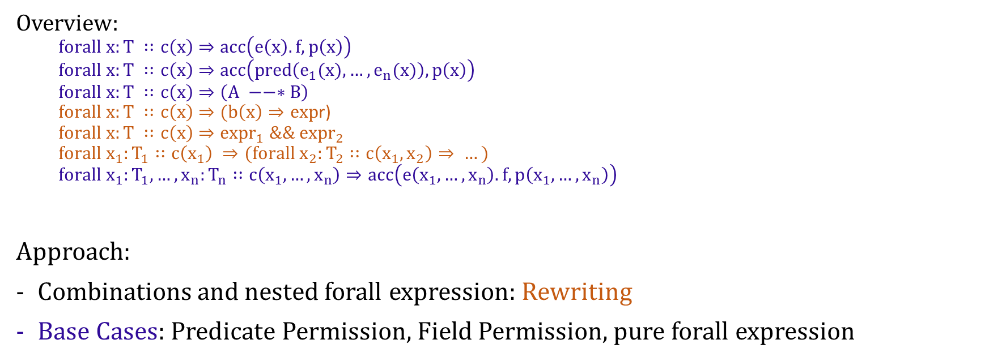
Quantified Permissions
Overview:
$$forall x:T ∷c\left(x\right)⇒acc\left(e\left(x\right).f, p\left(x\right)\right)$$
$$forall x:T ∷c\left(x\right)⇒acc\left(pred\left(e_{1}(x),…,e_{n}(x)\right), p\left(x\right)\right)$$
$$forall x:T ∷c\left(x\right)⇒\left(A −−∗B\right)$$
$forall x:T ∷c\left(x\right)⇒(b\left(x\right)⇒exp$r)
$$forall x:T ∷c\left(x\right)⇒{expr}_{1} \&\& {expr}_{2}$$
$$forall{ x}_{1}:T_{1}∷c\left(x_{1}\right) ⇒(forall{ x}_{2}:T_{2}∷c\left(x_{1}, x_{2}\right)⇒ …)$$
$$forall x_{1}:T_{1},…,x_{n}:T_{n}∷c\left(x_{1}, …,x_{n}\right)⇒acc\left(e\left(x_{1}, …,x_{n}\right).f, p\left(x_{1}, …,x_{n}\right)\right)$$
Approach:
Combinations and nested forall expression: Rewriting
Base Cases: Predicate Permission, Field Permission, pure forall expression

Slide 13
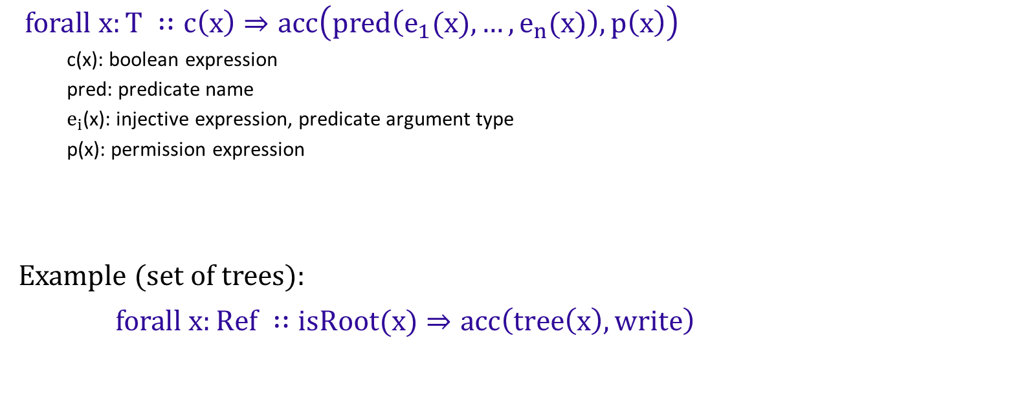
Quantified Predicate Permissions
$forall x:T ∷c\left(x\right)⇒acc\left(pred\left(e_{1}(x),…,e_{n}(x)\right), p\left(x\right)\right)$
c(x): boolean expression
pred: predicate name
$e_{i}$(x): injective expression, predicate argument type
p(x): permission expression
Example (set of trees):
$forall x:Ref ∷isRoot(x)⇒acc\left(tree\left(x\right), write\right)$

Slide 14
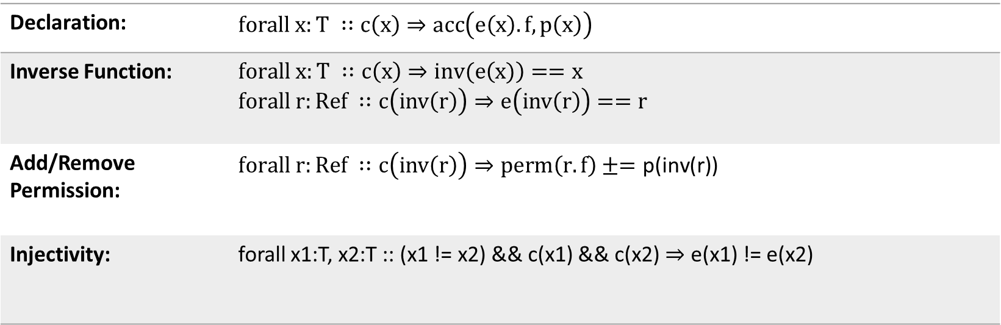
Quantified Field Permissions
Declaration: | $$forall x:T ∷c\left(x\right)⇒acc\left(e\left(x\right).f, p\left(x\right)\right)$$
Inverse Function: | $$forall x:T ∷c\left(x\right)⇒inv(e\left(x)\right)==x$$ $$forall r:Ref ∷c\left(inv\left(r\right)\right)⇒e\left(inv\left(r\right)\right)==r$$
Add/Remove Permission: | $$forall r:Ref ∷c\left(inv\left(r\right)\right)⇒perm\left(r.f\right)±=\text{p}\text{(}\text{inv}\text{(}\text{r}\text{))}$$
Injectivity: | forall x1:T, x2:T :: (x1 != x2) && c(x1) && c(x2) $⇒$ e(x1) != e(x2)

Slide 15
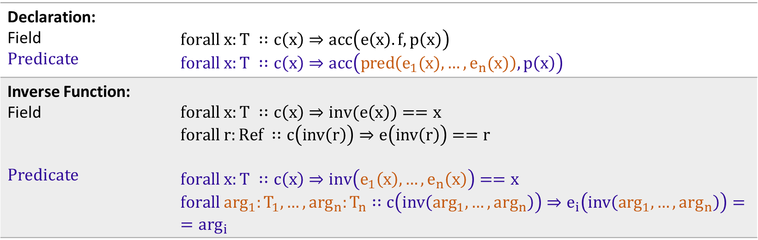
Quantified Permissions
Declaration: Field Predicate | $$forall x:T ∷c\left(x\right)⇒acc\left(e\left(x\right).f, p\left(x\right)\right)$$ $$forall x:T ∷c\left(x\right)⇒acc\left(pred\left(e_{1}(x),…,e_{n}(x)\right), p\left(x\right)\right)$$
Inverse Function: Field Predicate | $$forall x:T ∷c\left(x\right)⇒inv(e\left(x\right))==x$$ $$forall r:Ref ∷c\left(inv\left(r\right)\right)⇒e\left(inv\left(r\right)\right)==r$$ $$forall x:T ∷c\left(x\right)⇒inv\left(e_{1}\left(x\right),…,e_{n}\left(x\right)\right)==x$$ $$forall \arg_{1}:T_{1},…,\arg_{n}:T_{n}∷c\left(inv\left(\arg_{1}, …,\arg_{n}\right)\right)⇒e_{i}\left(inv\left(\arg_{1}, …,\arg_{n}\right)\right)==\arg_{i}$$

Slide 16
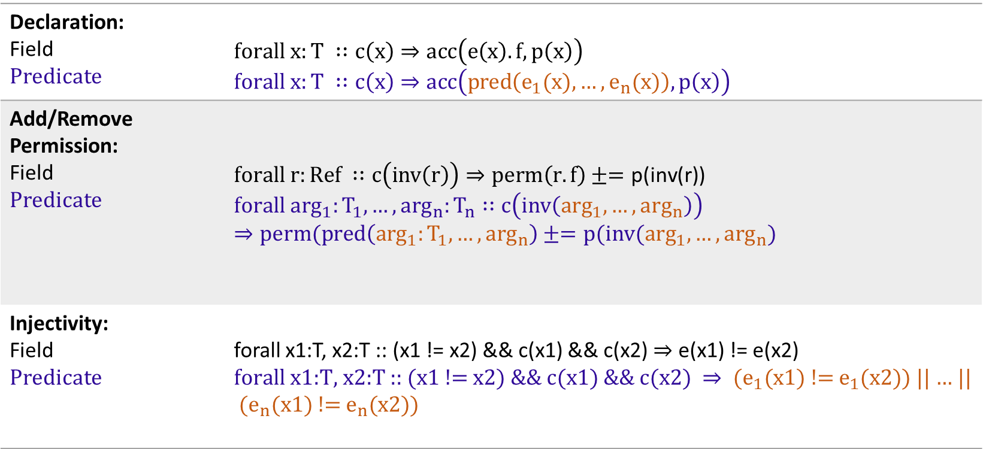
Quantified Permissions
Declaration: Field Predicate | $$forall x:T ∷c\left(x\right)⇒acc\left(e\left(x\right).f, p\left(x\right)\right)$$ $$forall x:T ∷c\left(x\right)⇒acc\left(pred\left(e_{1}(x),…,e_{n}(x)\right), p\left(x\right)\right)$$
Add/Remove Permission: Field Predicate | $$forall r:Ref ∷c\left(inv\left(r\right)\right)⇒perm\left(r.f\right)±=\text{p}\text{(}\text{inv}\text{(}\text{r}\text{))}$$ $$forall \arg_{1}:T_{1},…,\arg_{n}:T_{n}∷c\left(inv\left(\arg_{1}, …,\arg_{n}\right)\right)⇒perm(pred\left(\arg_{1}:T_{1},…,\arg_{n}\right)±=p(inv(\arg_{1},…,\arg_{n})$$
Injectivity: Field Predicate | forall x1:T, x2:T :: (x1 != x2) && c(x1) && c(x2) $⇒$ e(x1) != e(x2) $\text{forall} \text{x}\text{1:}\text{T}\text{, }\text{x}\text{2:}\text{T}\text{ :: (}\text{x}\text{1 != }\text{x}\text{2) \&\& }\text{c}\text{(}\text{x}\text{1) \&\& }\text{c}\text{(}\text{x}\text{2) }⇒ {(e}_{1}\text{(}\text{x}\text{1) != }e_{1}\text{(}\text{x}\text{2)}$) || … || ${(e}_{n}\text{(}\text{x}\text{1) != }e_{n}\text{(}\text{x}\text{2)}$)

Slide 17
Demo

Slide 18
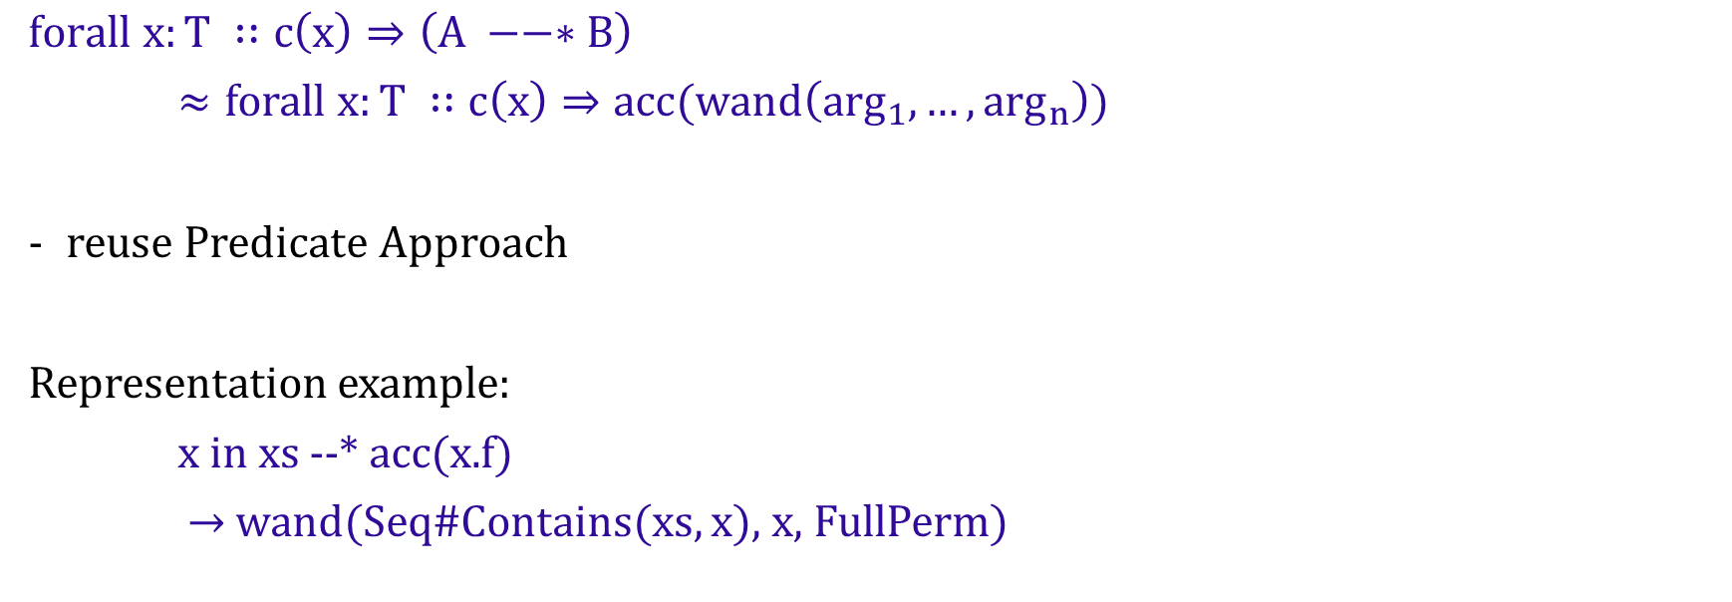
Quantified Magic Wand Permissions
might depend on x
$$forall x:T ∷c\left(x\right)⇒\left(A −−∗B\right)$$
$≈forall x:T ∷c\left(x\right)⇒acc(wand\left(\arg_{1}, …,\arg_{n}\right))$
reuse Predicate Approach
Representation example:
x in xs --* acc(x.f)
$→$wand(Seq#Contains(xs, x), x, FullPerm)

Slide 19
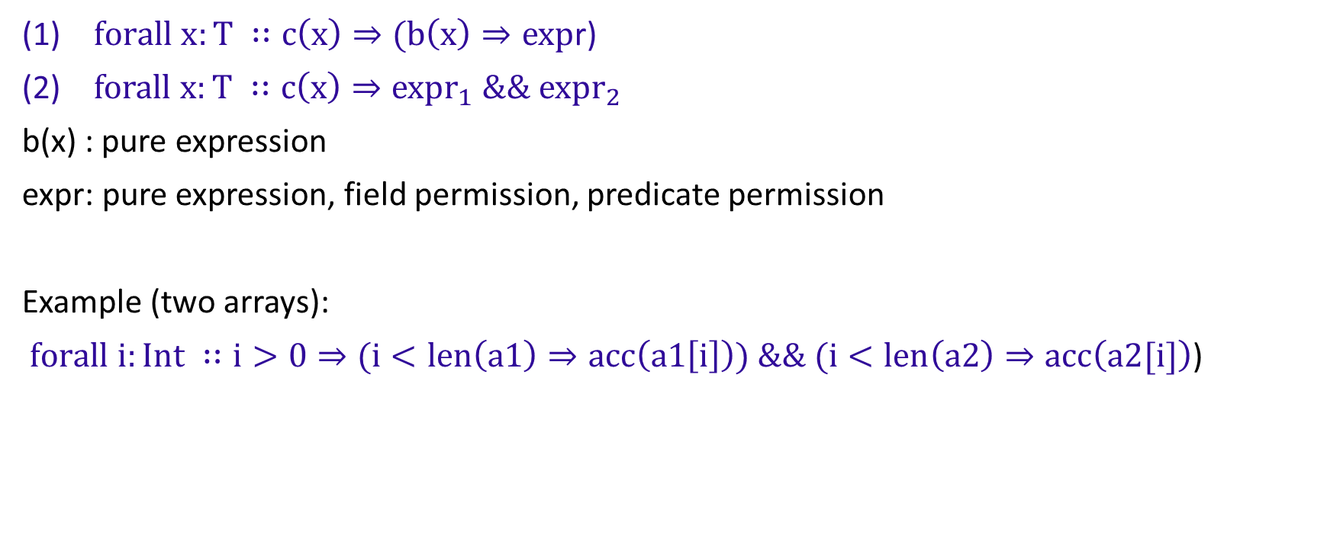
Combinations with pure Quantifiers and Quantified Permissions
$forall x:T ∷c\left(x\right)⇒(b\left(x\right)⇒exp$r)
$forall x:T ∷c\left(x\right)⇒{expr}_{1} \&\& {expr}_{2}$
b(x) : pure expression
expr: pure expression, field permission, predicate permission
Example (two arrays):
$forall i:Int ∷i>0⇒(i<len\left(a1\right)⇒acc\left(a1\left[i\right]\right)) \&\& (i<len\left(a2\right)⇒acc\left(a2[i]\right)$)

Slide 20

Combination: Rewriting Rules
$forall x:T ∷c\left(x\right)⇒(b\left(x\right)⇒expr)$
$→forall x:T ∷(c\left(x\right) \&\& b(x))⇒expr$
$forall x:T ∷c\left(x\right)⇒{expr}_{1} \&\& {expr}_{2}$
$→forall x:T ∷c\left(x\right)⇒{expr}_{1}$
$→forall x:T ∷c\left(x\right)⇒{expr}_{2}$

Slide 21

Combination: Example
$forall x:Ref ∷x in xs⇒$ ((i >= 0) $⇒$ acc(x.f) ) && ((i < 0) $⇒$ acc(x.g) )
$→$
$forall x:Ref ∷x in xs⇒$ ((i >= 0) $⇒$ acc(x.f))
$→$ $forall x:Ref ∷(\left(x in xs\right) \&\& i≥0)⇒$acc(x.f)
$forall x:Ref ∷x in xs⇒\text{ ((}\text{i}\text{ < }\text{0}\text{) }⇒ \text{acc}\text{(}\text{x}\text{.}\text{g}\text{) ) }$
$→ forall x:Ref ∷(\left(x in xs\right) \&\& i<0)⇒\text{acc}\text{(}\text{x}\text{.}\text{g}\text{)}$

Slide 22

Combination: Example
$forall x:Ref ∷x in xs⇒$ ((i >= 0) $⇒$ acc(x.f) ) && ((i < 0) $⇒$ acc(x.g) )
$→$
$forall x:Ref ∷x in xs⇒$ ((i >= 0) $⇒$ acc(x.f))
$→$ $forall x:Ref ∷(\left(x in xs\right) \&\& i≥0)⇒$acc(x.f)
$forall x:Ref ∷x in xs⇒\text{ ((}\text{i}\text{ < }\text{0}\text{) }⇒ \text{acc}\text{(}\text{x}\text{.}\text{g}\text{) ) }$
$→ forall x:Ref ∷(\left(x in xs\right) \&\& i<0)⇒\text{acc}\text{(}\text{x}\text{.}\text{g}\text{)}$

Slide 23
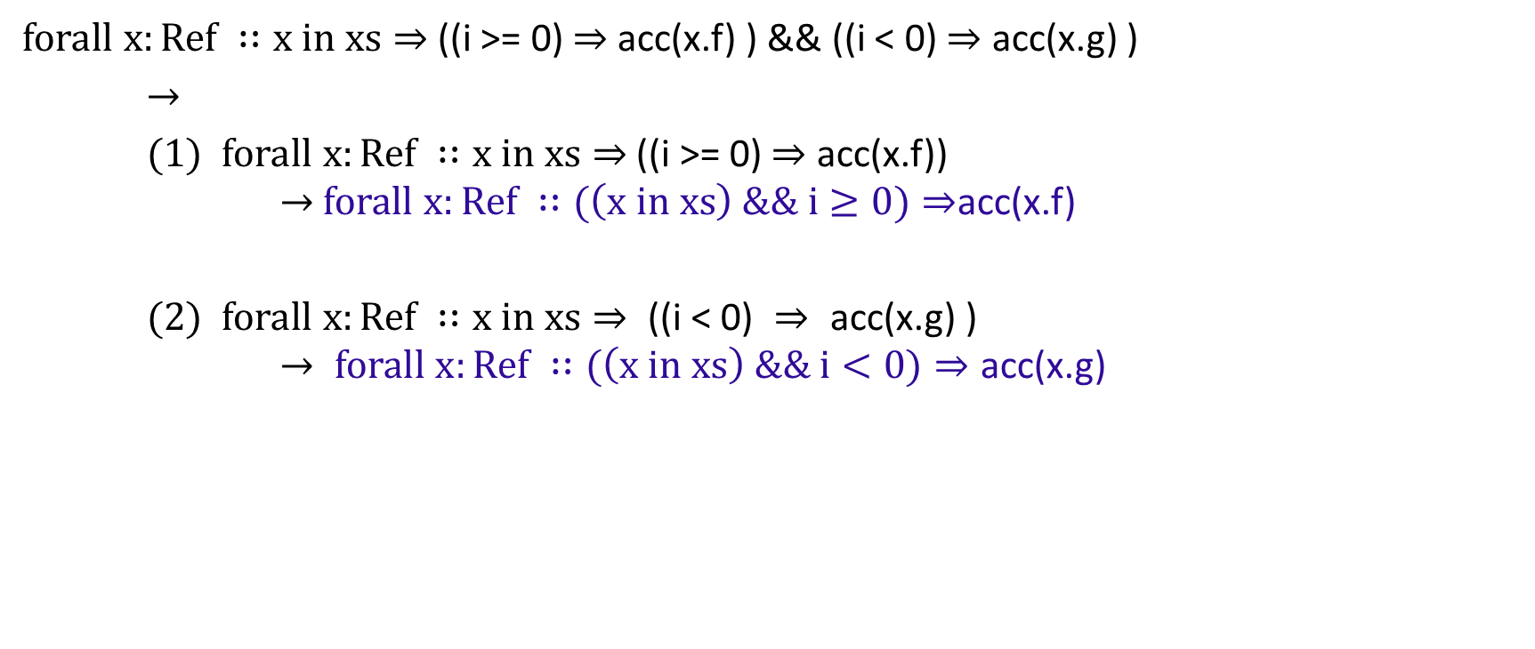
Combination: Example
$forall x:Ref ∷x in xs⇒$ ((i >= 0) $⇒$ acc(x.f) ) && ((i < 0) $⇒$ acc(x.g) )
$→$
$forall x:Ref ∷x in xs⇒$ ((i >= 0) $⇒$ acc(x.f))
$→$ $forall x:Ref ∷(\left(x in xs\right) \&\& i≥0)⇒$acc(x.f)
$forall x:Ref ∷x in xs⇒\text{ ((}\text{i}\text{ < }\text{0}\text{) }⇒ \text{acc}\text{(}\text{x}\text{.}\text{g}\text{) ) }$
$→ forall x:Ref ∷(\left(x in xs\right) \&\& i<0)⇒\text{acc}\text{(}\text{x}\text{.}\text{g}\text{)}$

Slide 24
Demo

Slide 25
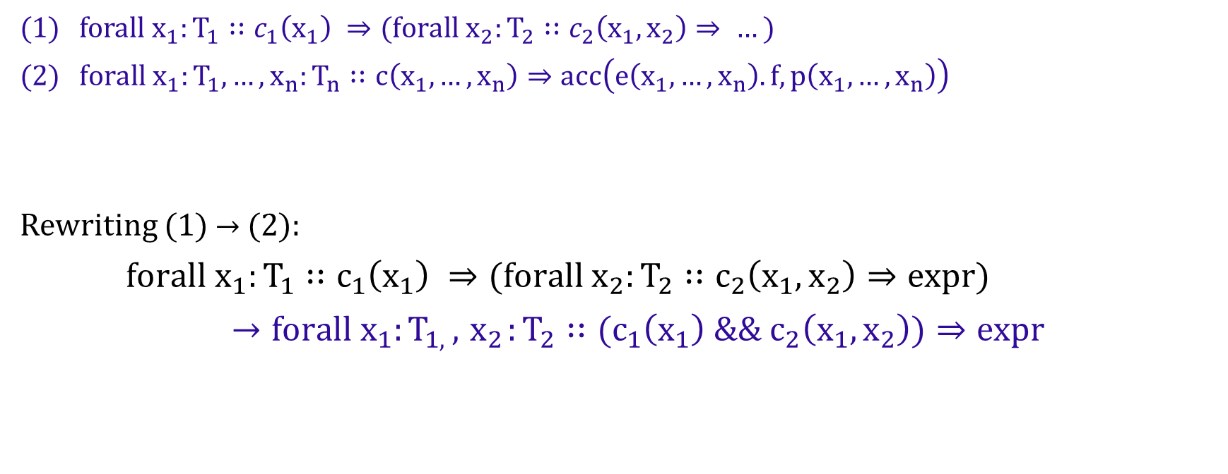
Nested Quantified Permissions
$forall{ x}_{1}:T_{1}∷c_{1}\left(x_{1}\right) ⇒(forall{ x}_{2}:T_{2}∷c_{2}\left(x_{1}, x_{2}\right)⇒ …)$
$forall x_{1}:T_{1},…,x_{n}:T_{n}∷c\left(x_{1}, …,x_{n}\right)⇒acc\left(e\left(x_{1}, …,x_{n}\right).f, p\left(x_{1}, …,x_{n}\right)\right)$
Rewriting (1) $→$ (2):
$forall{ x}_{1}:T_{1}∷c_{1}\left(x_{1}\right) ⇒(forall{ x}_{2}:T_{2}∷c_{2}\left({x_{1}, x}_{2}\right)⇒expr)$
$→forall{ x}_{1}:T_{1, },{ x}_{2}:T_{2}∷(c_{1}\left(x_{1}\right) \&\&{ c}_{2}\left({x_{1}, x}_{2}\right))⇒expr$

Slide 26
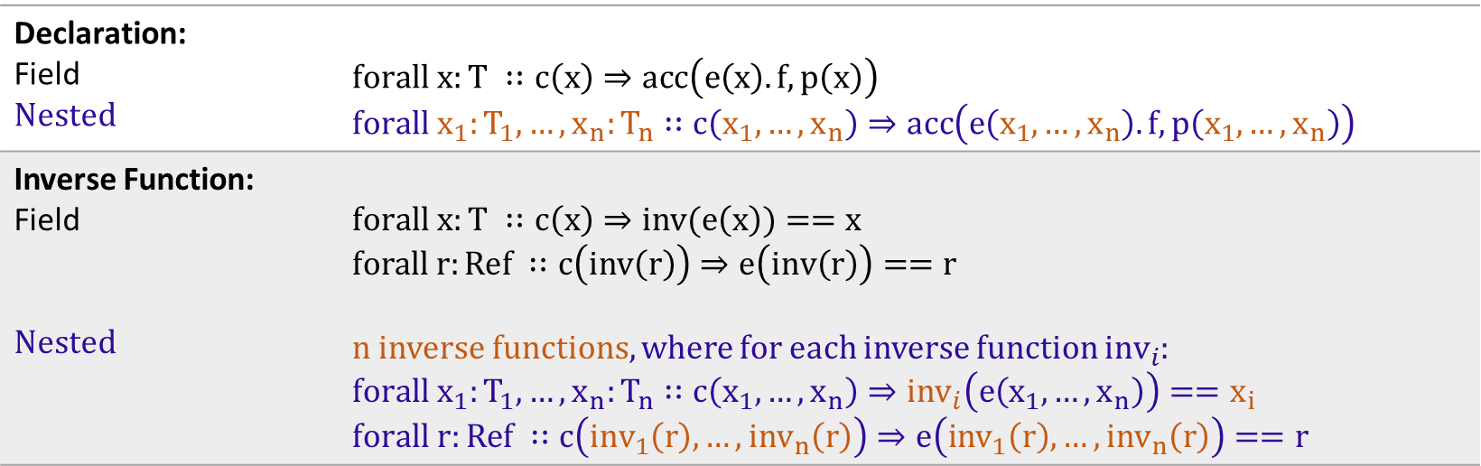
Quantified Permissions
Declaration: Field Nested | $$forall x:T ∷c\left(x\right)⇒acc\left(e\left(x\right).f, p\left(x\right)\right)$$ $$forall x_{1}:T_{1},…,x_{n}:T_{n}∷c\left(x_{1}, …,x_{n}\right)⇒acc\left(e\left(x_{1}, …,x_{n}\right).f, p\left(x_{1}, …,x_{n}\right)\right)$$
Inverse Function: Field Nested | $$forall x:T ∷c\left(x\right)⇒inv(e\left(x\right))==x$$ $$forall r:Ref ∷c\left(inv\left(r\right)\right)⇒e\left(inv\left(r\right)\right)==r$$ n inverse functions, where for each inverse function ${inv}_{i}$: $$forall{ x}_{1}:T_{1},…,x_{n}:T_{n}∷c\left(x_{1}, …,x_{n}\right)⇒{inv}_{i}\left(e\left(x_{1}, …,x_{n}\right)\right)==x_{i}$$ $$forall r:Ref ∷c\left({inv}_{1}\left(r\right), …,{inv}_{n}\left(r\right)\right)⇒e\left({inv}_{1}\left(r\right), …,{inv}_{n}\left(r\right)\right)==r$$

Slide 27
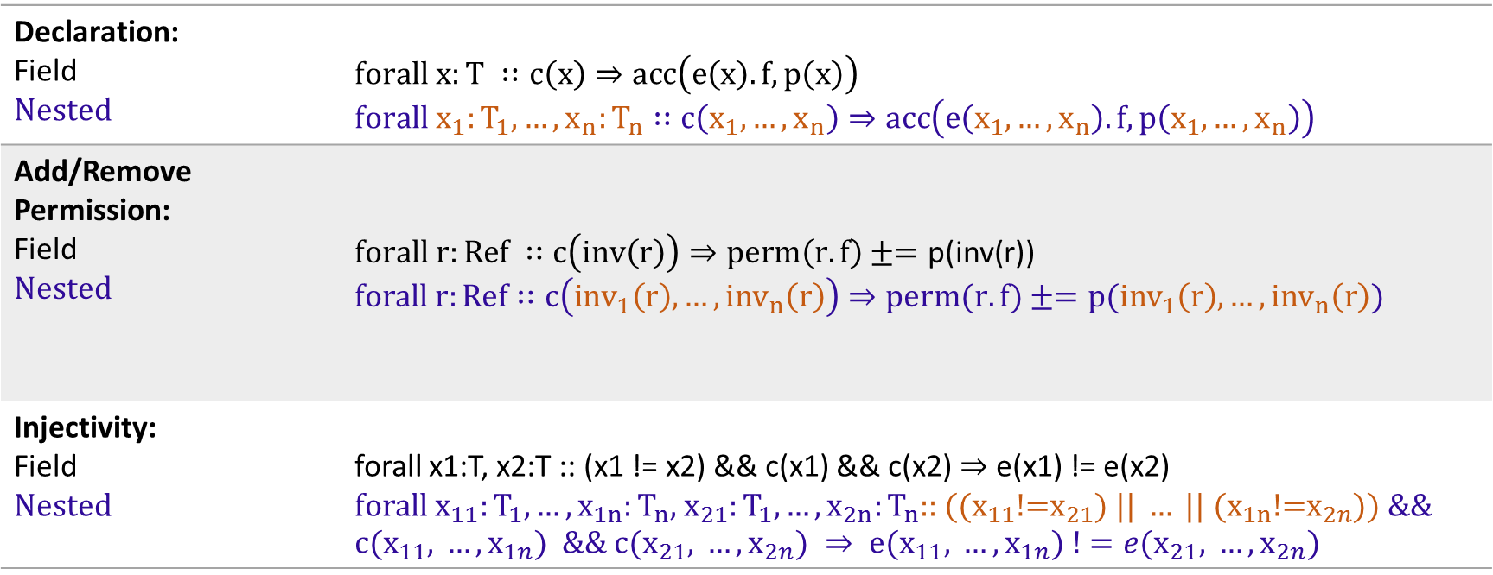
Quantified Permissions
Declaration: Field Nested | $$forall x:T ∷c\left(x\right)⇒acc\left(e\left(x\right).f, p\left(x\right)\right)$$ $$forall x_{1}:T_{1},…,x_{n}:T_{n}∷c\left(x_{1}, …,x_{n}\right)⇒acc\left(e\left(x_{1}, …,x_{n}\right).f, p\left(x_{1}, …,x_{n}\right)\right)$$
Add/Remove Permission: Field Nested | $$forall r:Ref ∷c\left(inv\left(r\right)\right)⇒perm\left(r.f\right)±=\text{p}\text{(}\text{inv}\text{(}\text{r}\text{))}$$ $$forall r:Ref∷c\left({inv}_{1}\left(r\right), …,{inv}_{n}\left(r\right)\right)⇒perm(r.f)±=p({inv}_{1}\left(r\right), …,{inv}_{n}\left(r\right))$$
Injectivity: Field Nested | forall x1:T, x2:T :: (x1 != x2) && c(x1) && c(x2) $⇒$ e(x1) != e(x2) $$\text{forall} x_{11}:T_{1},…,x_{1n}:T_{n}\text{,} x_{21}:T_{1},…,x_{2n}:T_{n}\text{:: ((}x_{11}\text{!=}x_{21}\text{) || }…\text{ || (}x_{1n}\text{!=}x_{2n}\text{)) }\text{\&\& }\text{c}\text{(}x_{11}\text{, }…,x_{1n}\text{) \&\& }\text{c}\text{(}x_{21}\text{, }…,x_{2n}\text{) }⇒ \text{e}\text{(}x_{11}\text{, }…,x_{1n}) !=e(x_{21}\text{, }…,x_{2n})$$

Slide 28
Further Work
- Allowing user-given Triggers
Implementation in Silicon (Core Goal):
combinations of quantified pure and permission-based assertions
predicate support within quantified permissions
Implementation in Carbon and/or Silicon (Extension):
magic wand support within quantified permissions
nested quantified permissions

Slide 29
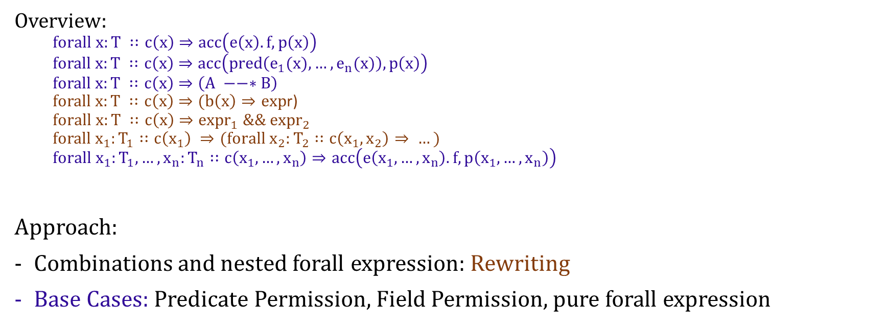
Quantified Permissions
Overview:
$$forall x:T ∷c\left(x\right)⇒acc\left(e\left(x\right).f, p\left(x\right)\right)$$
$$forall x:T ∷c\left(x\right)⇒acc\left(pred\left(e_{1}(x),…,e_{n}(x)\right), p\left(x\right)\right)$$
$$forall x:T ∷c\left(x\right)⇒\left(A −−∗B\right)$$
$forall x:T ∷c\left(x\right)⇒(b\left(x\right)⇒exp$r)
$$forall x:T ∷c\left(x\right)⇒{expr}_{1} \&\& {expr}_{2}$$
$$forall{ x}_{1}:T_{1}∷c\left(x_{1}\right) ⇒(forall{ x}_{2}:T_{2}∷c\left(x_{1}, x_{2}\right)⇒ …)$$
$$forall x_{1}:T_{1},…,x_{n}:T_{n}∷c\left(x_{1}, …,x_{n}\right)⇒acc\left(e\left(x_{1}, …,x_{n}\right).f, p\left(x_{1}, …,x_{n}\right)\right)$$
Approach:
Combinations and nested forall expression: Rewriting
Base Cases: Predicate Permission, Field Permission, pure forall expression

